Slide 1
Fountain Code Network Transmission
Austin Wolcott
Montclair State University
Master of Science; Cybersecurity
Advisor: Christopher Leberknight

Slide 2
Outline
Introduction: Slide 3
Literature Review: Slide 4
Project Overview: Slide 5
Limitations: Slide 16
Future Research: Slide 17
Bibliography: Slide 18

Slide 3
Introduction
Lossy networks cause imperfect data transmission
Leads to retransmission
Fountain codes allow for data reconstruction
Could be expanded to circumvent censorship

Slide 4
Literature Review
MacKay (2005) suggests that Fountain Codes could be effectively used in long-term storage devices and data broadcasting
Qureshi et al. (2014) discussed various types of Fountain Codes, including Reed-Solomon erasure codes, Raptor Codes, and Luby Transform Codes
Du (2012) discusses LT codes in relation to soliton distributions, and a degree distribution with only one parameter. This was found to be more efficient

Slide 5
Project Overview
Implement TCP chatroom
Clients connect to a centralized server, which broadcasts messages
Messages are encoded via LT codes before being sent to the server
The encoded messages are received by other clients, which each decode the data

Slide 6
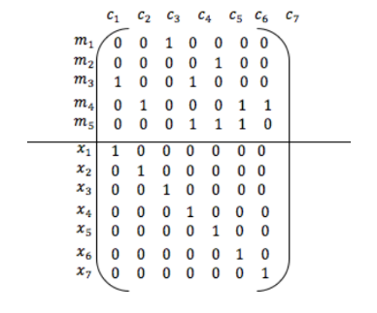
Fountain Code Encoding
Plaintext is broken up into chunks
Random chunks are XOR’d together to generate unique tokens
Some tokens are left as pieces of plaintext
(Brar and Sandhu, 2016)

Slide 7
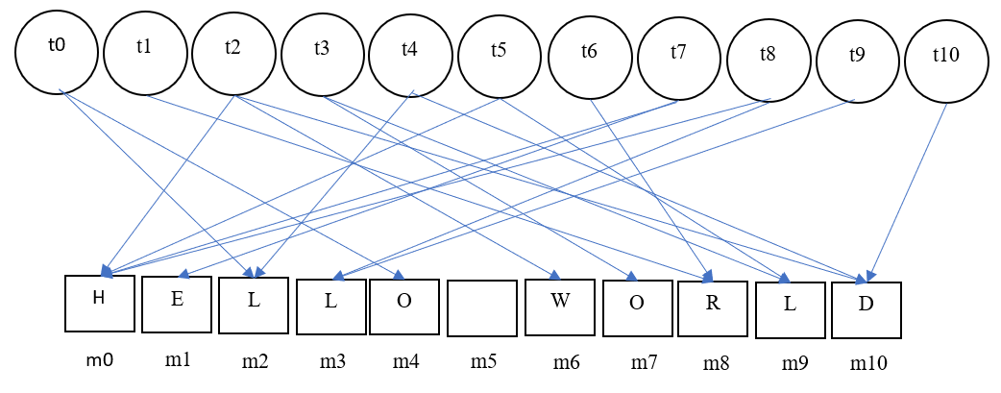
Fountain Code Decoding
The receiver is able to begin decoding the message upon receipt of a portion of data
XORing tokens and plaintext can calculate the original plaintext chunks
XORing is symmetric, meaning it can be decoded the same way it was encoded
This leads to a waterfall effect

Slide 8
Fountain Code Applications
Useful for networks where packets are likely to be:
Dropped
Lost
Using UDP
Congested TCP
A link is down

Slide 9
Our Implementation: Chat Server
Multiple clients
Central server
Router
TCP socket connections
Modified existing code to implement functionality

Slide 10
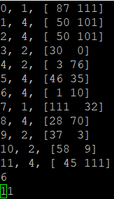
Our Implementation: Encoding/Transmission
User input gets saved to a file on the client machine
Encoded
Tokens are saved to an encrypted file
The encrypted file is sent to the server via TCP
The server receives the file and reflects it to every connected client
No data is saved on the server

Slide 11
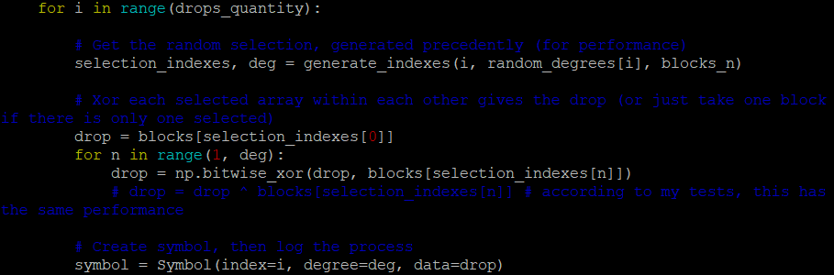
Computing encoded tokens _{[encoder.py]}

Slide 12
Our Implementation of Decoding/Cleanup
Each client decodes the message
Prints message to new file
Decoded message printed to user
Intermediate files deleted

Slide 13
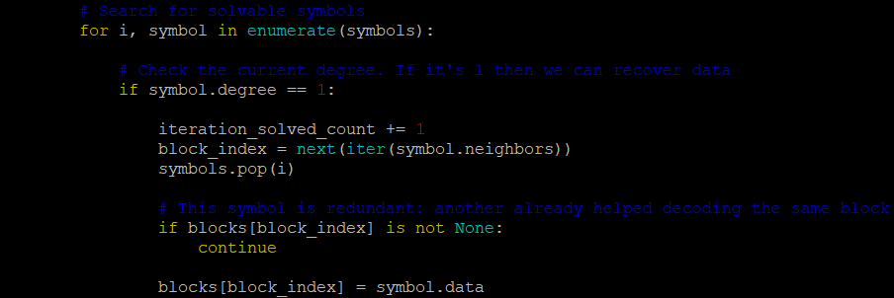
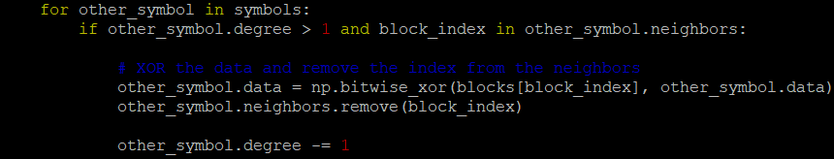
Computing decoded tokens _{[decoder.py]}
Updating dependencies_{[decoder.py]}

Slide 14
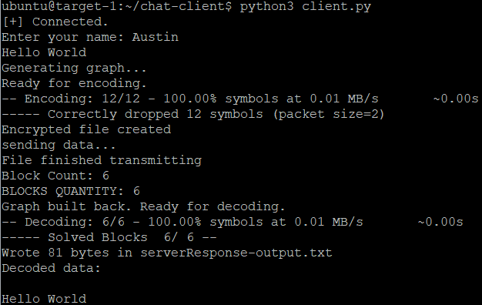

Slide 15
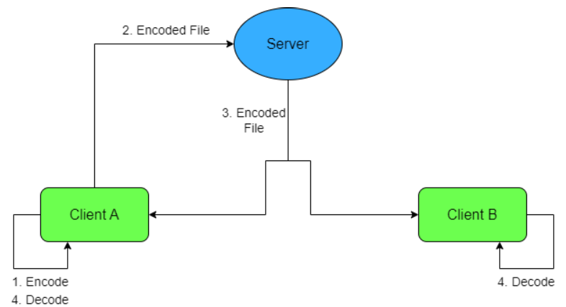

Slide 16
Limitations
Integrity not ensured
Message not properly decoded if message is certain length
Message can’t always be decoded
Potential malicious attacks

Slide 17
Future Research
Hash checking
Bug fixes
Intrusion Detection/Prevention System implementation
Allow user to send message as Fountain Code, Covert Channels, or as plaintext
Allow user to send already existing files

Slide 18
Bibliography
Azab, A., Khasawneh, M., Alrabaee, S., Choo, K.-K. R., & Sarsour, M. (2022). Network traffic classification: Techniques, datasets, and challenges. Digital Communications and Networks. https://doi.org/10.1016/j.dcan.2022.09.009
Brar, A. S., & Sandhu, A. S. (2016). Design and Implementation of Enhanced Model of Fountain Codes for Unicast Transmission. Indian Journal of Science and Technology.
Du, Qingxiao. “Implementation of lt code with A novel degree distribution.” Open Journal of Applied Sciences, vol. 02, no. 04, 2012, pp. 203–207, https://doi.org/10.4236/ojapps.2012.24b046.
Chang, S. K., Yang, K. C., & Wang, J. S. (2008, May). Unequal-protected LT code for layered video streaming. In 2008 IEEE International Conference on Communications (pp. 500-504). IEEE.Hourt, N., Kar, K., & Ganguly, B. (2013, November). Performance of loss-tolerant TCP (LT-TCP) in the presence of correlated losses. In MILCOM 2013-2013 IEEE Military Communications Conference (pp. 1341-1346). IEEE.
Hourt, N., Kar, K., & Ganguly, B. (2013, November). Performance of loss-tolerant TCP (LT-TCP) in the presence of correlated losses. In MILCOM 2013-2013 IEEE Military Communications Conference (pp. 1341-1346). IEEE.
MacKay, D. J. (2005). Fountain codes. IEE Proceedings-Communications, 152(6), 1062-1068.
MacKay, D. J. C. (2005). Capacity Approaching Codes Design and Implementation. Fountain Codes, IEE Proc-Commun, 152(6).
Marciniszyn, E. (2022). Fountain codes and covert channels (Doctoral dissertation, Master’s thesis, FernUniversität in Hagen, Germany).
Qureshi, J., Heng Foh, C., & Cai, J. (2014). Primer and recent developments on Fountain Codes. Recent Advances in Communications and Networking Technology, 2(1), 2–11. https://doi.org/10.2174/22117407112019990001
Singh Brar, Anmol, and Amandeep Singh Sandhu. “Design and implementation of enhanced model of fountain codes for unicast transmission.” Indian Journal of Science and Technology, vol. 9, no. 19, 31 May 2016, https://doi.org/10.17485/ijst/2016/v9i19/92876.
Spriteware. (n.d.). Spriteware/Lt-Codes-Python: Fountain code: Efficient python implementation of lt codes. GitHub. https://github.com/Spriteware/lt-codes-python
Tian, J., Xiong, G., Li, Z., & Gou, G. (2020). A survey of key technologies for Constructing Network Covert Channel. Security and Communication Networks, 2020, 1–20. https://doi.org/10.1155/2020/8892896

Slide 19
Links
Original chat server code
https://thepythoncode.com/article/make-a-chat-room-application-in-python#google_vignette%20https://github.com/x4nth055/pythoncode-tutorials/tree/master/python-%20standard-library/chat-application
Original fountain code scripts
https://github.com/Spriteware/lt-codes-python/tree/master
Github
https://github.com/leberkc/Fountain-Code

Slide 20
Demonstration
Short Message
Hello World
Medium Message
This message may normally be blocked because it contains the word 'terrorism'
Long Message:
Shall I compare thee to a summers day? Thou art more lovely and more temperate: Rough winds do shake the darling buds of May, And summers lease hath all too short a date: Sometime too hot the eye of heaven shines, And often is his gold complexion dimmd; And every fair from fair sometime declines, By chance or natures changing course untrimmd; But thy eternal summer shall not fade Nor lose possession of that fair thou owest; Nor shall Death brag thou wanderst in his shade, When in eternal lines to time thou growest: So long as men can breathe or eyes can see, So long lives this and this gives life to thee
Demo video: https://drive.google.com/uc?id=1ZWL6MEiVfHVuOdnPjNQJiS6cK_Ghsn1_&export=download

